Slide 1
A Midsummer Night’s Dream Analysis Act 2!
Presentation By:
Xavier
Nakari
Landon
Nick
Corey

Slide 2
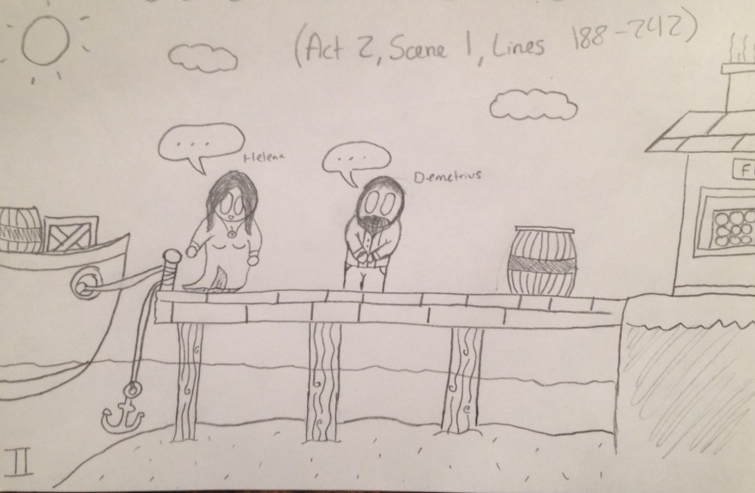
Illustrations of Important Events in Act 2!
(A.2,S.1,L.188-242)
Takes place in:
Rising Action
Speaker:
Helena and Demetrius
“I love thee not…I’ll follow thee and make a heaven of hell.”

Slide 3
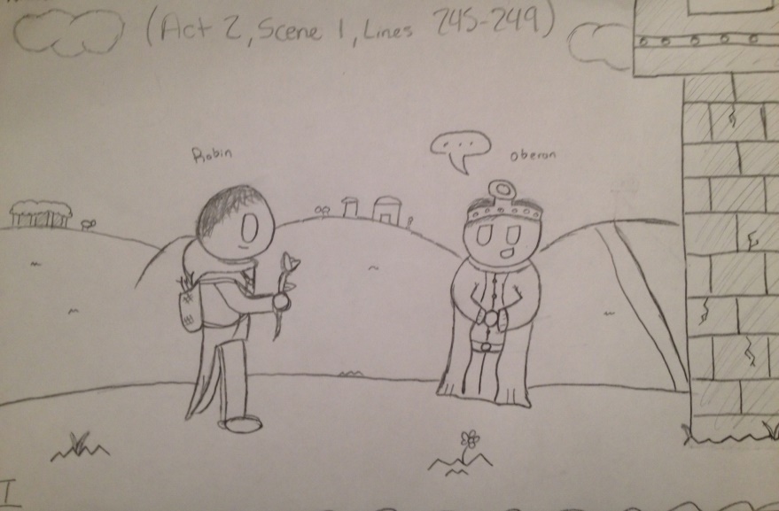
Illustrations of Important Events in Act 2! (cont.)
(A.2,S.1,L.245-249)
Takes place in:
Conclusion
Speaker:
Oberon to Robin
“Fare thee well nymph…I pray thee give it me.”

Slide 4
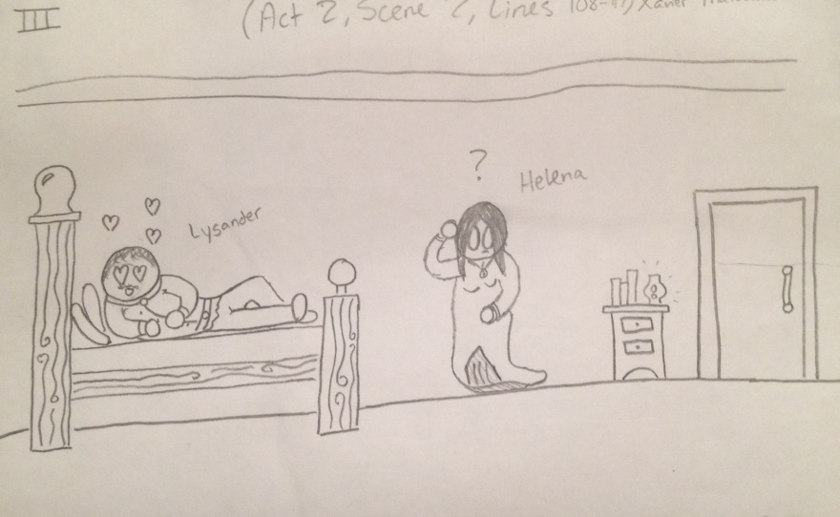
Illustrations of Important Events in Act 2! (cont.)
(A.2,S.1,L.108-117)
Takes place in:
Climax
Speaker:
Lysander and Helena
“Lysander, if you live…Yet Hermia still loves you. Then be content.”

Slide 5
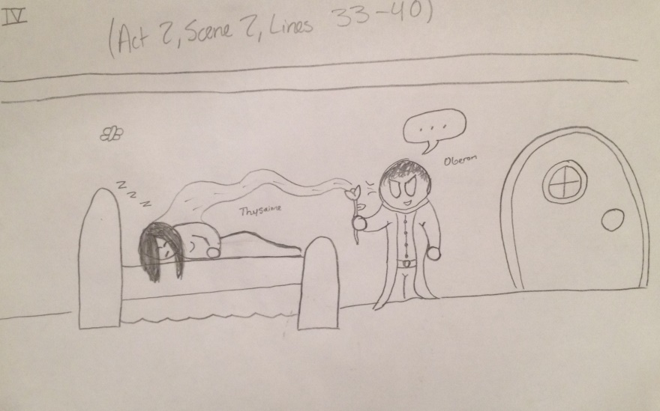
Illustrations of Important Events in Act 2! (cont.)
(A.2,S.1,L.33-40)
Takes place in:
Exposition
Speaker:
Oberon to Titania
“What thou seest when thou dost wake…some vile thing is near.”

Slide 6
Dramatic Literary Terms Used in Act 2!
Stage Left: [Titania and her fairies exit.]
Dialogue: Helena- “You draw me, you hard-hearted adamant!” Demetrius- “Do I entice you?”
3. Figurative Language: “And I am sick when I look not on you.”
4. Scene: Egeus- “Happy be Theseus, our renowned duke!” Theseus- “Thanks, good Egeus. What’s the news with thee?”
5. Set: The woods which the scene takes place.

Slide 7
Dramatic Literary Terms Used in Act 2! (cont.)
6. Act: Hermia- “With half that with the wisher’s eye be pressed.”
7. Logos: Helena- “O, wilt thou darkling leave me? Do not so.” Demetrius- “Stay on thy peril. I alone will go.”
8. Tragedy: They couldn’t find the Indian boy.
9. Tragic Flaw: The last scene they lost the boy and couldn’t find him.
10. Pathos: Hermia- “Yet Hermia still loves you. Then be content.”

Slide 8
Character STEAL | Question: | Example | Inference
Speech | What does the character say? How does the character speak? | “Give me that boy and I will go thee.” | He speaks this way to express his dominance over the boy.
Thoughts | What is revealed through the character’s private thoughts? | He expresses how badly he wants the boy. | The way he thinks shows that he really cares inside.
Effects on Characters | What is revealed through the character’s effect on people? | “Not for thy fairy kingdom. Fairies, away.” | They refuse to give him the boy.
Actions | What does the character do? | “Well, go thy way. Thou shalt not from this grove. Till I torment thee for this injury.” | He threatens them for the boy.
Looks | What does the character look like? | The editor says that he’s a king. | The character might look like a general king.

Slide 9
Theme of Act 2 with Concrete Details!
Theme: Taking something that does not belong to you often results in an bad manner.
“For Oberon is passing fell and wrath Because that she, as her attendant, hath a lovely boy stolen from an Indian king.”
(A.2,S.1,L.20-23)
“Jealous Oberon would have the child knight of his train.”
(A.2,S.1,L.24-25)
“She perforce withholds the loved boy.” (A.2,S.1,L.26)
“When thou hast stolen away from fairyland.” (A.2,S.1,L.65)
“Didst not thou lead him through the glimmering night?”
(A.2,S.1,L.77-78)

Slide 10
Theme of Act 2 with Concrete Details!
“These are the forgeries of jealousy.”
(A.2,S.1,L.81)
“As in revenge have sucked up from the sea.”
(A.2,S.1,L.89)
“The fold stands empty in the drowned field.”
(A.2,S.1,L.96)
“And this same progeny of evils…parents and originals.”
(A.2,S.1,L.115-117)
“I do but beg a little changeling boy.”
(A.2,S.1,L.120)

Slide 11
Text Structure Identification in Act 2!
The story was told in a very dramatic way. It had the form of a poem, but is performed and shown as a play.
Main Characters:
Oberon
Titania
Robin
Fairy
Supporting Characters:
Demetrius
Helena
Stage Direction Examples:
[Enter a fairy at one door
and Robin Goodfellow at another]
[Titania and her fairies exit]
[Helena exits]
[Robin gives him the flower]

Slide 12
fin

